Slide 1
Agile for Model-Based Standards Development
Brandon Sapp
Melissa Harvey
Sylvere Krima
Marion Toussaint

Slide 2
Presentation Overview
Statement of Business Need
Problem Statement
Proposed Solutions
Benefits/Impacts
Next Steps

Slide 3
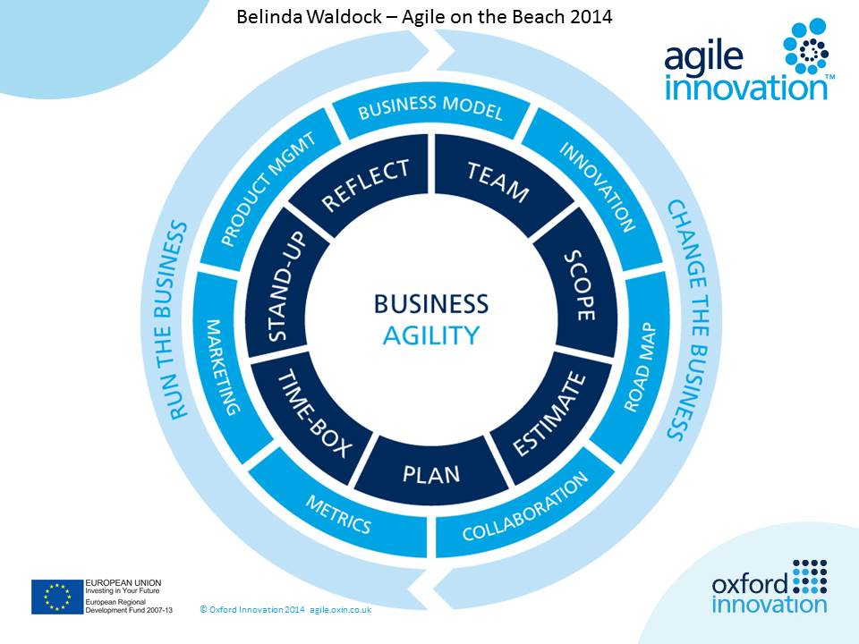
Business/Industry Needs
Agile for Model-Based-Standards Development
Business Scenarios
Business Consequences
Today, organizations are more aware of the importance of the digital integration and exchange of information assets.
Hence, information standards are developed to ensure an optimal interoperability and compatibility between information assets in order to exploit and process these assets in a consistent fashion.
Information requirements are not represented in the standard (i.e. gaps).
Time to reduce gaps (standards development) is not keeping with the speed of business need.
Interim interoperability cause non-value added costs to the business to:
OEM Submission of Technical Data Package to Authority for Certification
Manufacturing and Support Enablement
Design Integration
Manual re-entry and remodeling
Conversion cleanup
Cost of maintaining multiple CAD licenses
Supplier assertion costs

Slide 4
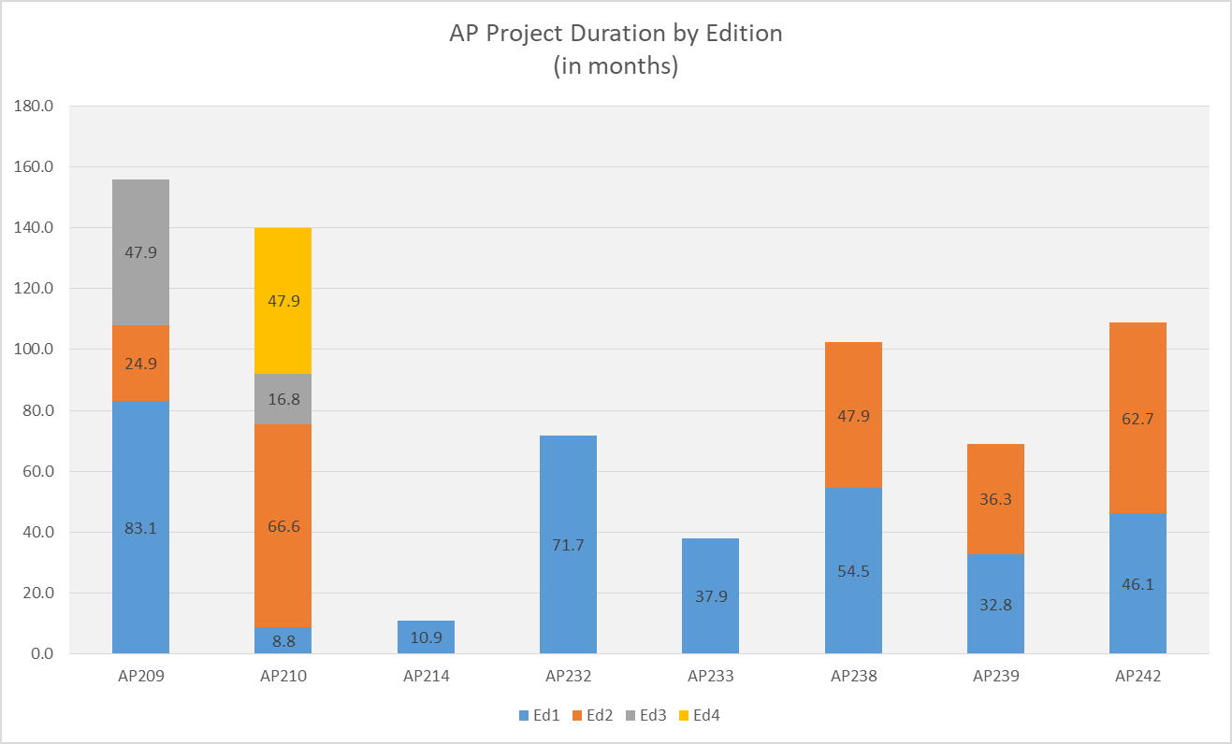
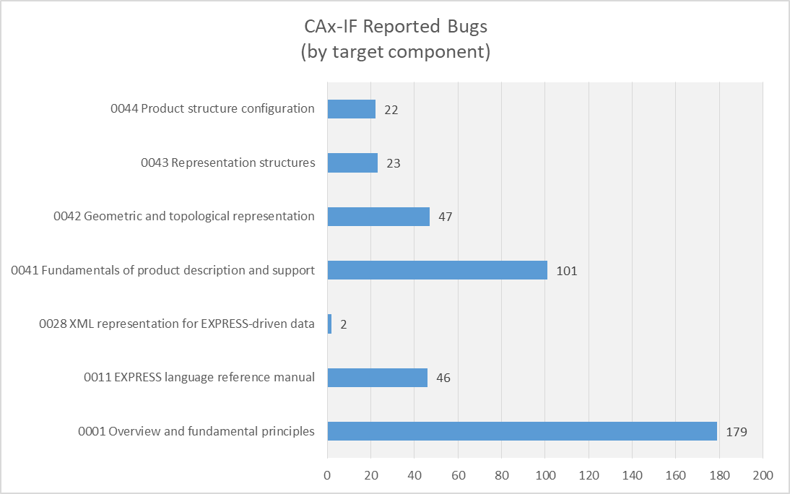
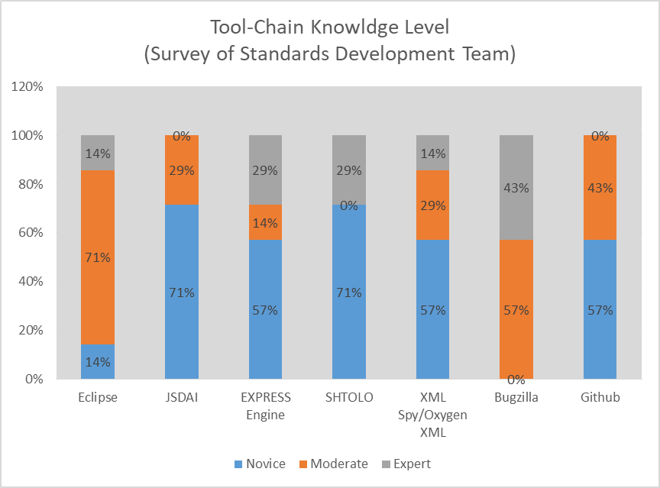
Problem Statement
Agile for Model-Based-Standards Development
Extended Development Time Length
Defects in Quality/Completeness of Releases
Failure to Gain Consensus
Non Optimized Tool-Chain
Lack of Workflow Constraints
Resource Commitment/Management
Volunteer Staff
Lack of Resources
Virtually Distributed Team
Lack of Knowledge
Attrition
Disjointed/Incomplete Training
Lack of Adequate Tool-Chain
Manually Integrated (process controlled)
Outdated Tools
Tools Extended Past Intended Usage
Notes:
Extended Length
sample across 8 standards and 16 edition publishes revealed the
current average project duration is 43.5 months (stage 10.99 to stage 60.60)
growth of 4.5 months from ed1 to ed2
Quality
Data Quality Issues
Incomplete Solutions
Overtly Complex/Non Implementable Solutions

Slide 5
Proposed Solution 1: Backlog Management
Mel/Brandon
Agile for Model-Based-Standards Development
Current State
Proposed Future State
Bugzilla
All issues are a bug
Bulk milestone assignment
Assessment performed during project
JIRA
New items assigned as (fig below)
Establish/maintain priority ranking
Assign product owner/manager role
actively manages the backlog by reprioritizing, adjusting, grooming and adding to the backlog
Benefit:
prevent the backlog from getting too big or out of date.
It will also provide reliable work that is ready for the team to assign to a sprint
Bug*
Product (ISO10303)
Bug*
Bug*
Bug*
Epic
Task
Improvement
New Feature
Subtask
Task
Task
Sub-Task
Sub-Task

Slide 6




Proposed Solution 2: Agile Release Train
Agile for Model-Based-Standards Development
AP239e4 (ART/EPIC)
AP243e1 (ART/EPIC)
AP242e3
(ART/EPIC)
PMI Team
Define
Build
Test
Deploy
Agile Teams
EWH
Team
Define
Build
Test
Deploy
AM Team
Scrum Master Product Owner Development Team
Notes:
Problem with traditional development methods leads to long project phases for:
requirements documentation
product development
integration
Review
Publication
Agile represents an opportunity to
shorten the development
Provide usable products to the user faster
Applicable Manifesto:
“Deliver working software frequently.”
“Working software is the primary measure of progress.“
“At regular intervals, the team reflects on how to become more effective, then tunes and adjust its behavior accordingly.”
Recently integration issues with AP242 e2 teams could have been avoided with synchronized and integrated development iterations
employing systems thinking and applying an operating cadence and synchronization that enables all the teams to sprint together while integrating

Slide 7
Proposed Solution 3: Program Increment Planning
Mel/Brandon
Agile for Model-Based-Standards Development
AP242e3
(ART/EPIC)
Hole & Fastener Extension
(Features, Improvements, Tasks)
program increment
(1-4 wks work)
program increment
(1-4 wks work)
PMI Team
Implicit Holes
Implicit Fasteners
Explicit Holes
Explicit Fasteners
Define
Build
Test
Deploy
EWH
Team
Features, Improvements, Tasks
program increment
program increment
Define
Build
Test
Deploy
User Story
User Story
User Story
User Story
AM Team
Agile Teams
Scrum Master Product Owner Development Team

Slide 8
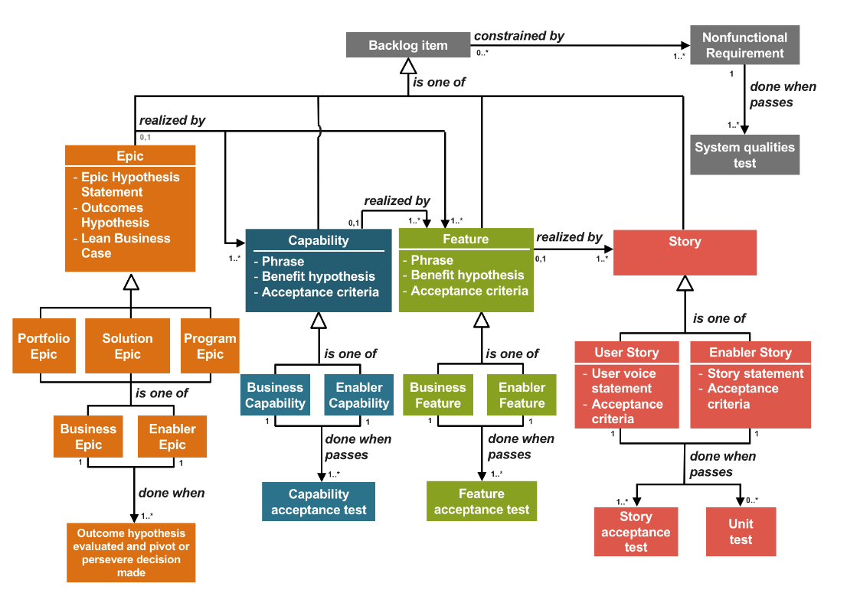
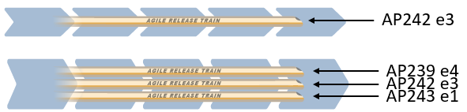
Continued Research 1: Advanced Communication Tools
Agile for Model-Based-Standards Development
ART
Marion

Slide 9
Continued Research 2: Continuous Integration
Agile for Model-Based-Standards Development
ART
Marion/Sylvere

Slide 10
Benefits & Impacts
Agile for Model-Based-Standards Development
Benefits to MBS Developer
Benefits to Industry/Enterprise
Immediate feedback loop to detect and fix issues early
Increase transparency and visibility to other developers and team members
Avoid “integration hell”
Improve quality and testability
Increase speed of standards supporting info requirements gap closure
Reduction in interoperability costs (supplier assertion reduction, manual reentry, conversion)
Sylvere

Slide 11
Next Steps
Agile for Model-Based-Standards Development
Implement:
Backlog Management
JIRA or GIT KANBANs
Agile Release Train
JIRA Workflow Management
Program Increment Planning
JIRA Workflow Management
Planning Poker, T-Shirt Sizes, Dot Voting
Continued Research:
Advanced Communication Tools (for consensus management; requirements traceability)
Continuous Integration Tools & Automation (Bitbucket/Bamboo, Jenkins, AWS CodePipeline, and Gitlab)
EXPRESS Engine, JSDAI Compiles, Python scripts or ANT Builds

